Slide 1





Introduction to
Elastic Search

Slide 2


Extensively!
Have you ever used the Elastic Stack before?
In Maxxton!
Basic!
Notes:
Something to say here

Slide 3

Use Cases:
Logging
Metrics
Security Analytics
Business Analytics
Notes:
Speaking about use case

Slide 4
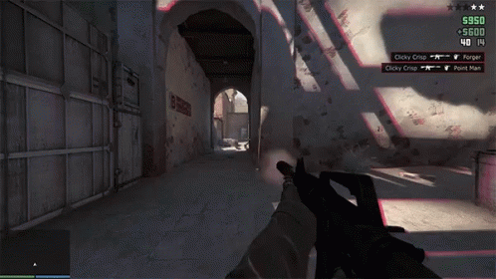
Use Cases: Logging

Slide 5
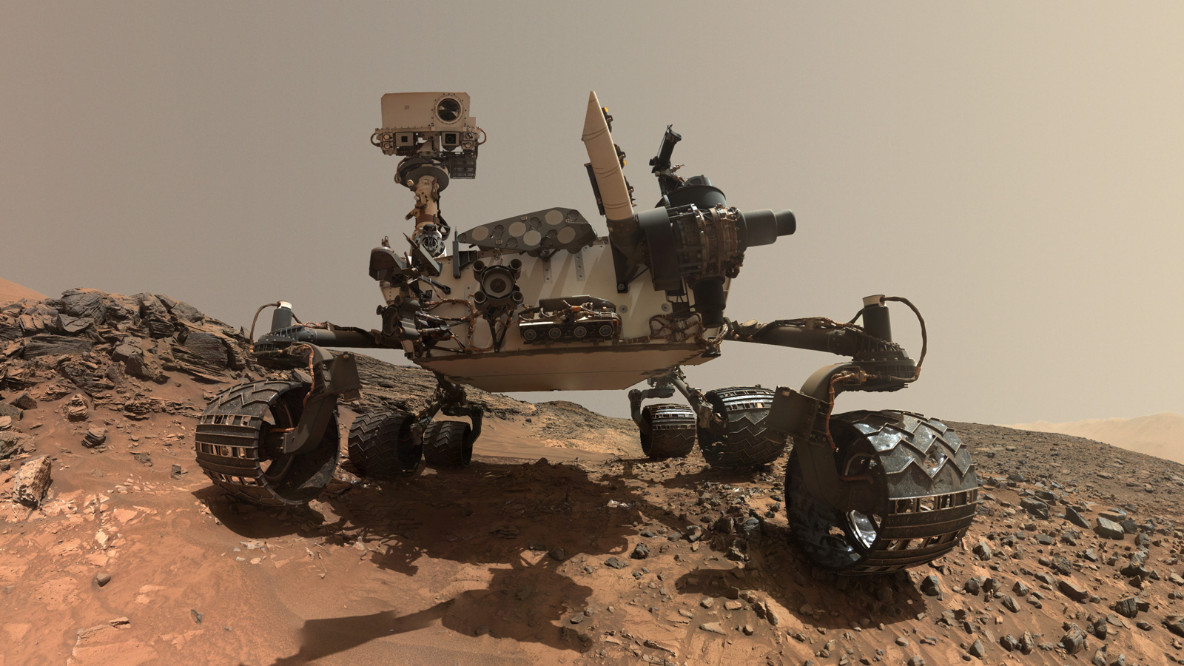

Use Cases: Metrics

Slide 6

Use Cases: Security Analytics

Slide 7
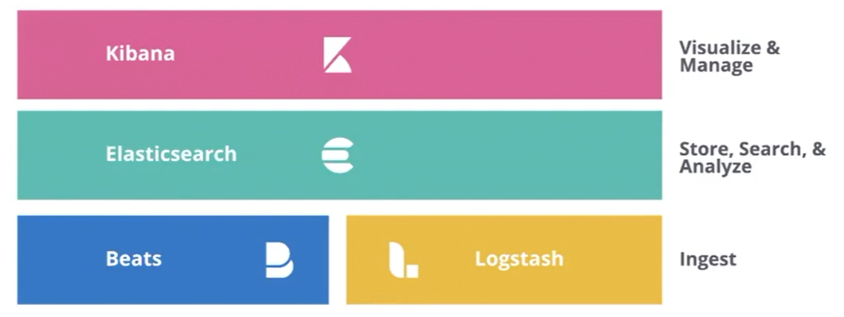
The Elastic Stack
Reliably and securely take data from any source, in any format, then search, analyse, and visualise it in real time

Slide 8
What is our agenda
Basic example of how the components of Elastic Stack work together.
Setting up elasticsearch and kibana locally
Understand basic architecture of Elasticsearch
Concept of Sharding and Replication - Shards, Replica Shards
CRUD
Routing
Analyser in Elasticsearch
Inverted Index

Slide 9
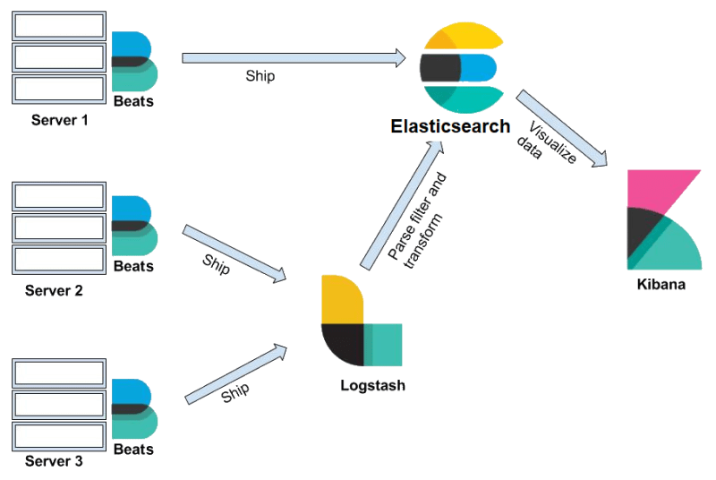
Beats
Beats is a collection of data shippers.

Slide 10
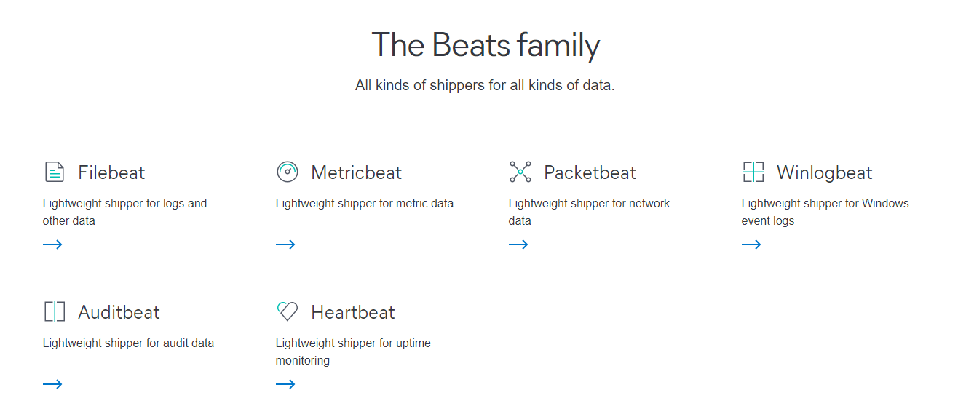

Slide 11
Logstash
Logstash is a data processing pipeline

Slide 12

STORE | SEARCH | ANALYSE

Slide 13
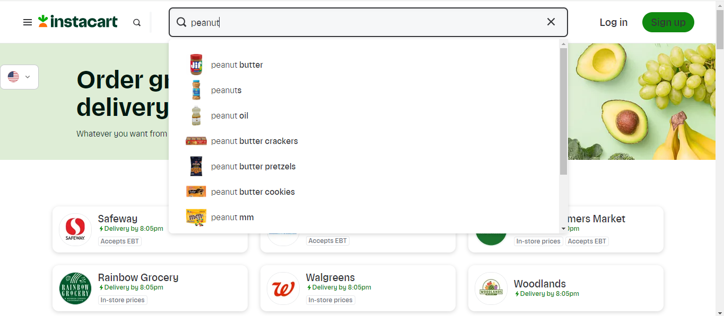
Great Search Experience = Get fast and relevant results, no matter the scale

Slide 14
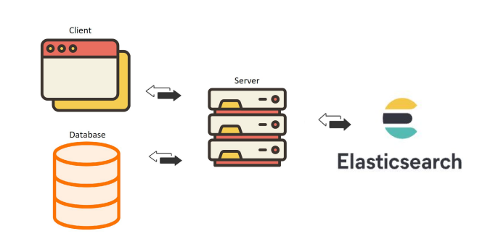

Slide 15
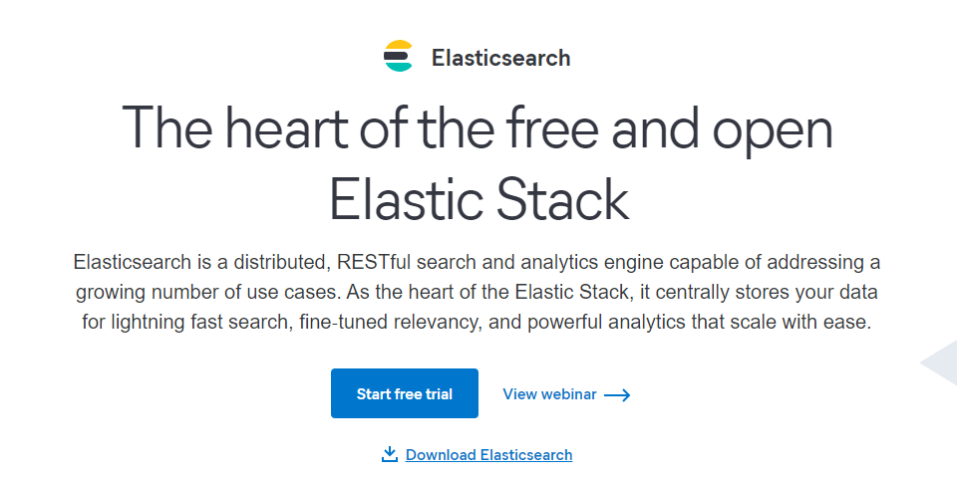

Slide 16
Communicates through its REST APIs

Slide 17
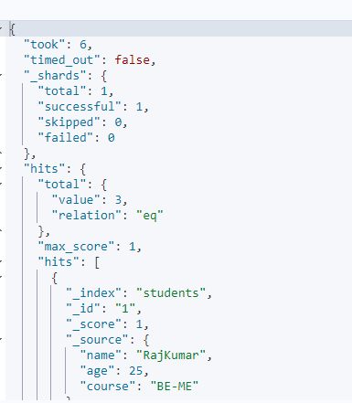
And on the low level the transfer of data takes places as JSON objects. Be it receiving data or responding to a search query its JSON objects.

Slide 18
Kibana
Kibana brings more meaning and insight to data in visual format

Slide 19
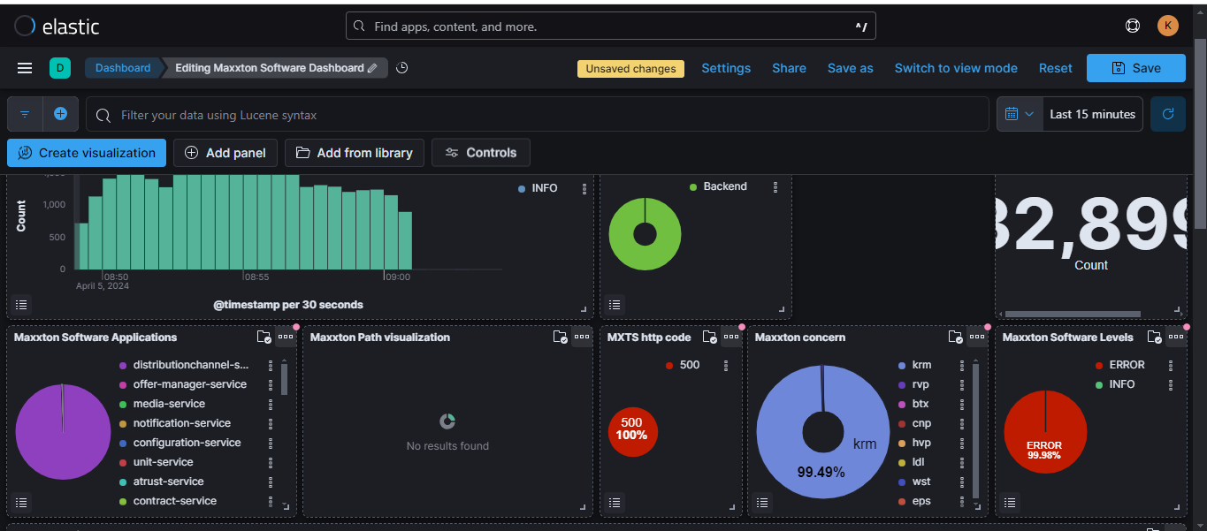

Slide 20
The Elastic Stack
Reliably and securely take data from any source, in any format, then search, analyse, and visualise it in real time

Slide 21
What is our agenda
Basic example of how the components of Elastic Stack work together.
Setting up elasticsearch and kibana locally
Understand basic architecture of Elasticsearch
Concept of Sharding and Replication - Shards, Replica Shards
CRUD
Routing
Analyser in Elasticsearch
Inverted Index

Slide 22
What is our agenda
Basic example of how the components of Elastic Stack work together.
Setting up elasticsearch and kibana locally
Understand basic architecture of Elasticsearch
Concept of Sharding - Shards, Replica Shards
CRUD
Routing
Analyser in Elasticsearch
Inverted Index

Slide 23
Cluster
Hi! I am a NODE, a running instance of elasticsearch
I belong to a single cluster
I have a unique ID and a name
Node-1

Slide 24
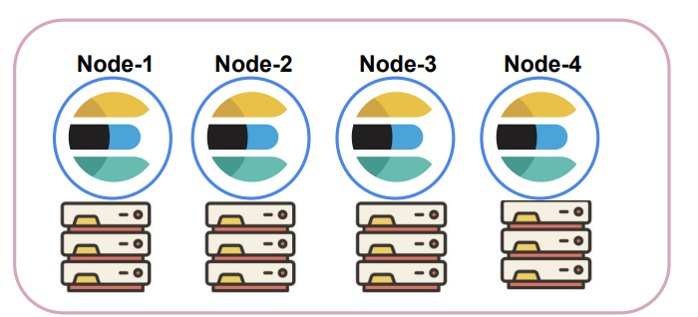
Cluster

Slide 25


Slide 26
Cluster

Slide 27
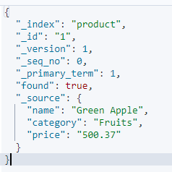
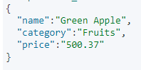
Data is stored as Documents in Elasticsearch!
I am a document, a JSON object that stores received input along with some metadata

Slide 28
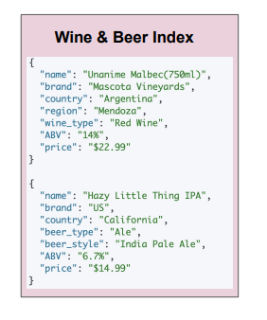
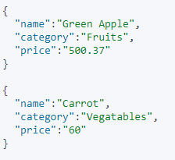
Data are grouped into an Index
Produce Index

Slide 29
To Summarise
The cluster is a collection of multiple nodes distributed across various machines.
Each of these nodes have their own roles. One out of which is to store data.
Data is stored as documents (JSON input + metadata).
Logically related documents are grouped under indices.

Slide 30
What is our agenda
Basic example of how the components of Elastic Stack work together.
Setting up elasticsearch and kibana locally
Understand basic architecture of Elasticsearch
Concept of Sharding and Replication - Shards, Replica Shards
CRUD
Routing
Analyser in Elasticsearch
Inverted Index

Slide 31
What is a Shard?
Cluster
Hi! I am a shard. I hold documents related to Produce
Node-1
Node-2
Node-3
Produce Index
P0
P1
P2
Hi! I am a shard. I hold documents related to Wine and Beer
Wine and Beer Index
P0
P1
P2

Slide 32
What is a Sharding?
I can only hold 200K documents!!
Cluster
Node-1
Node-2
Node-3
Client
Food Truck Index
P0
P1
P2
I want to index 600K documents about food trucks

Slide 33
Sharding empowers Elasticsearch to increasing amount of data or demands placed on it
Cluster
Node-1
Node-2
Node-3
Node-4
Node-5
Food Truck Index
P0
P1
P2
P4
P5

Slide 34
What is a Sharding?
Cluster
I hold 500K produce documents
Node-1
Client
Produce Index
P0
Let’s assume I take 10s to search through these 500K documents!!
I want to find green apples!

Slide 35
Sharding speeds up our search !!
Cluster
We searched through the entire 500k documents in 1s!!
Node-1
Node-10
Produce Index
P0
P1
P2
P3
P4
P5
P6
P7
P8
P9
Now running a search on 50K documents takes me 1s!
I hold 50K produce documents

Slide 36


Cluster
Node-1
Node-10
Produce Index
P0
P1
P2
P3
P4
P5
P6
P7
P8
P9

Slide 37

Replication creates copies of the shards and keeps the copies in different nodes.
Cluster
Node-1
Node-2
Node-3
Node-4
Food Truck Index
P0
P1
R0
R1

Slide 38


Join at slido.com #1279246
ⓘ
Click Present with Slido or install our Chrome extension to display joining instructions for participants while presenting.
Notes:
📣 This is Slido interaction slide, please don't delete it. ✅ Click on 'Present with Slido' and the joining instructions will appear when you get to this slide.

Slide 39

Which of these is not a component of Elastic Stack?
ⓘ
Click Present with Slido or install our Chrome extension to activate this poll while presenting.
Notes:
📣 This is Slido interaction slide, please don't delete it. ✅ Click on 'Present with Slido' and the poll will launch automatically when you get to this slide.

Slide 40
Data is stored in Elasticsearch as __________
ⓘ
Click Present with Slido or install our Chrome extension to activate this poll while presenting.
Notes:
📣 This is Slido interaction slide, please don't delete it. ✅ Click on 'Present with Slido' and the poll will launch automatically when you get to this slide.

Slide 41
I am the running instance of Elasticsearch. Who am I?
ⓘ
Click Present with Slido or install our Chrome extension to activate this poll while presenting.
Notes:
📣 This is Slido interaction slide, please don't delete it. ✅ Click on 'Present with Slido' and the poll will launch automatically when you get to this slide.

Slide 42
A cluster can have only single node?
ⓘ
Click Present with Slido or install our Chrome extension to activate this poll while presenting.
Notes:
📣 This is Slido interaction slide, please don't delete it. ✅ Click on 'Present with Slido' and the poll will launch automatically when you get to this slide.

Slide 43
Which of these store documents and holds disk space?
ⓘ
Click Present with Slido or install our Chrome extension to activate this poll while presenting.
Notes:
📣 This is Slido interaction slide, please don't delete it. ✅ Click on 'Present with Slido' and the poll will launch automatically when you get to this slide.

Slide 44
Sharding is splitting of index into multiple shards to distributed across various machines?
ⓘ
Click Present with Slido or install our Chrome extension to activate this poll while presenting.
Notes:
📣 This is Slido interaction slide, please don't delete it. ✅ Click on 'Present with Slido' and the poll will launch automatically when you get to this slide.

Slide 45
Replica shards are assigned to the same node of its Primary Shard?
ⓘ
Click Present with Slido or install our Chrome extension to activate this poll while presenting.
Notes:
📣 This is Slido interaction slide, please don't delete it. ✅ Click on 'Present with Slido' and the poll will launch automatically when you get to this slide.

Slide 46
What is our agenda
Basic example of how the components of Elastic Stack work together.
Setting up elasticsearch and kibana locally
Understand basic architecture of Elasticsearch
Concept of Sharding and Replication - Shards, Replica Shards
CRUD operations
Routing
Basic Read/Write Model in Elasticsearch
Analyser in Elasticsearch
Inverted Index and Doc Values

Slide 47
What is our agenda
Basic example of how the components of Elastic Stack work together.
Setting up elasticsearch and kibana locally
Understand basic architecture of Elasticsearch
Concept of Sharding and Replication - Shards, Replica Shards
CRUD operations
Routing
Basic Read/Write Model in Elasticsearch
Analyser in Elasticsearch
Inverted Index and Doc Values

Slide 48
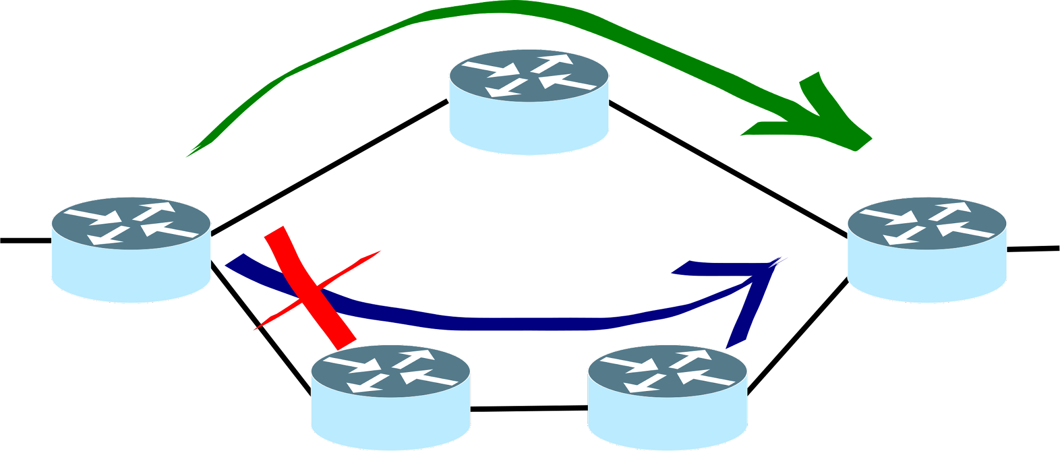
Routing
The process of resolving a shard for a document
shard_num = hash(_routing) % no_of_primary_shards
By default _routing = _id

Slide 49
What is our agenda
Basic example of how the components of Elastic Stack work together.
Setting up elasticsearch and kibana locally
Understand basic architecture of Elasticsearch
Concept of Sharding and Replication - Shards, Replica Shards
CRUD operations
Routing
Basic Read/Write Model in Elasticsearch
Analyser in Elasticsearch
Inverted Index and Doc Values

Slide 50
How Elasticsearch Reads data?
Basic Read Model
Client
GET students/_doc/32
.
Document
Coordination Node
Data Node
Routing
Replication Group
R
Adaptive Replica Selection

Slide 51
PUT students/_doc/32
Basic Write Model
Coordination Node
How Elasticsearch Writes data?
Routing
Replication Group
Validate Data
Save into Primary Shard
Save into Replica Shard

Slide 52
What is our agenda
Basic example of how the components of Elastic Stack work together.
Setting up elasticsearch and kibana locally
Understand basic architecture of Elasticsearch
Concept of Sharding and Replication - Shards, Replica Shards
CRUD operations
Routing
Basic Read/Write Model in Elasticsearch
Analyser in Elasticsearch
Inverted Index and Doc Values

Slide 53


Document
converting
converting text into terms
text
into
terms

Slide 54

Analysis
The process of converting text into terms that can be efficiently stored and searched
Elasticsearch uses a powerful text analysis engine to break down textual data into individual tokens or terms, which are then used to build an inverted index for fast and accurate full-text search

Slide 55
Character Filtering
Token Filtering
Tokenization
Three phases of analysis
Document

Slide 56
Character Filters
Tokenization
Token Filtering
“Hello, World!”
“Hello”, “World”
“hello”, “world”

Slide 57
What is our agenda
Basic example of how the components of Elastic Stack work together.
Setting up elasticsearch and kibana locally
Understand basic architecture of Elasticsearch
Concept of Sharding and Replication - Shards, Replica Shards
CRUD operations
Routing
Basic Read/Write Model in Elasticsearch
Analyser in Elasticsearch
Inverted Index and Doc Values

Slide 58
Analysis
The process of converting text into terms that can be efficiently stored and searched
Elasticsearch uses a powerful text analysis engine to break down textual data into individual tokens or terms, which are then used to build an inverted index for fast and accurate full-text search

Slide 59

Inverted Index
It is the backbone of Elasticsearch powerful and fast full-text search capabilities.

Slide 60
TNo | Term
TNo | DocId:Freq:Pos | DocId:Freq:Pos | DocId:Freq:Pos
1 | 1:1:1 | 2:1:3 | 3:2:[1,4]
2 | 1:1:2
3 | 1:1:3
4 | 1:1:4 | 3:1:2
5 | 2:1:1
6 | 2:1:2
7 | 2:1:4
8 | 2:1:5 | 3:1:5
9 | 3:1:3
1 | the
2 | quick
3 | brown
4 | fox
5 | jumped
6 | over
7 | lazy
8 | dog
9 | and
Document 1:
“The quick brown fox”
Document 2:
“Jumped over the lazy dog”
Document 3:
“The fox and the dog”

Slide 61
Doc Values
Elasticsearch uses these data structures to store numeric fields.
This allows for efficient numerical range queries and aggregations

Slide 62
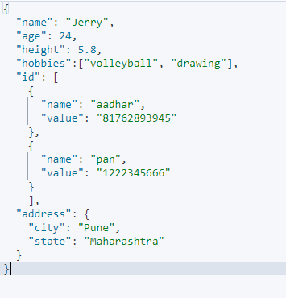
Inverted Index and Doc Values

Slide 63
What is our agenda
Basic example of how the components of Elastic Stack work together.
Setting up elasticsearch and kibana locally
Understand basic architecture of Elasticsearch
Concept of Sharding and Replication - Shards, Replica Shards
CRUD operations
Routing
Basic Read/Write Model in Elasticsearch
Analyser in Elasticsearch
Inverted Index and Doc Values
Mapping in Elasticsearch

